Slide 1
Simulating Quantum Systems on a Digital Quantum Computer Maria (Marika) Kieferova
Work package 1 – architecture and algorithms
WP leader: Michael Bremner

Slide 2
architecture, error correction, complexity, algorithms…
QUANTUM COMPUTING
fabrication, control, engineering,
connectivity, scaling…

Slide 3
2019: Google demonstrated classical inferiority
More in Michael’s talk!

Slide 4
What is the killer application of quantum computers?
What are problems where quantum computers eventually outperform classical computers?*
What problems can we solve more efficiently with 100/1000/10⁶ very good/logical qubits?
*Given some complexity theoretic assumptions

Slide 5
Quantum
advantage
scenario
When should we start using quantum computers? WP1 works to
- discover new applications
- reduce their physical requirements
- understand the influence of errors
- mitigate errors
- optimize implementations
Theorists
Experimentalists

Slide 6
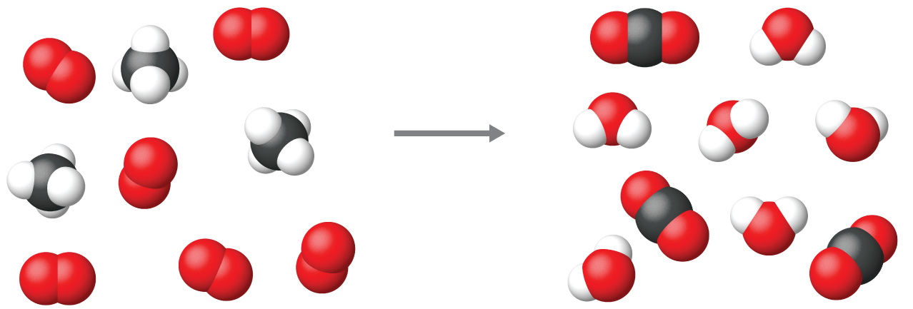
Natural application for quantum computing
simulation of quantum dynamics

Slide 7
The Hamiltonian simulation problem
Design a (logical) circuit U consisting of gates and Hamiltonian oracles that approximates the time evolution up to an error ϵ such that
${\left\|U−e^{−iHt}\right\|}_{2}<ε$.
The Hamiltonian oracle can represent
Access to matrix elements (H is sparse)
Terms $e^{−iH_{j}t}$ when $H=\sum_{j}{H_{j}}$ is given.

Slide 8
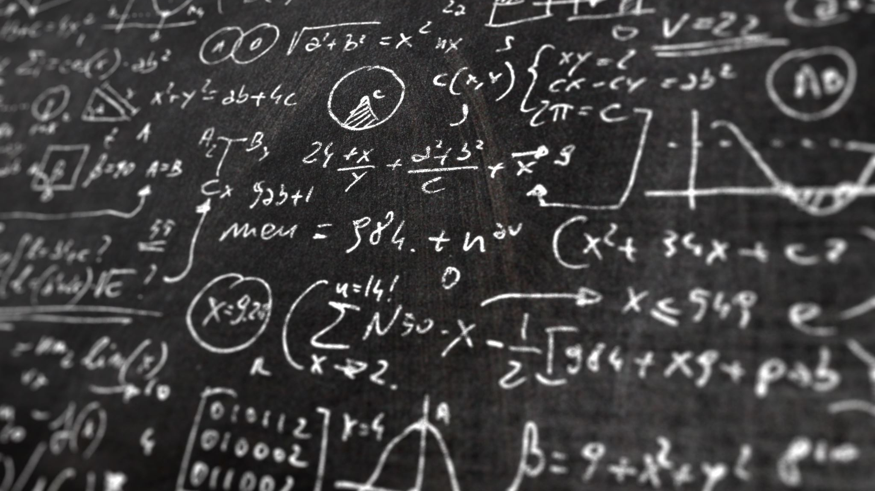
Why so abstract?
Simulation quantum dynamics
Implementation of adiabatic computation (optimization)
Subroutine for energy estimation
Techniques for linear systems, differential equations, machine learning…

Slide 9
Ground state energy computation
restart
no
Prepare an ansatz
A version of phase estimation
Did we obtain a
satisfying energy
estimate?
Output the energy
yes
Hamiltonian simulation
More about ground state energies in Michael’s talk!

Slide 10
Efficient ansantz preparation for fermionic systems
Simple to prepare state that has an overlap with the ground state.
Classically pre-computed Slater determinant
Antisymmetrizing states in the 1st quantization
NEW: Faster algorithm based on a reversed sort.
$$\left|\left.r_{1},…, r_{m}\right\rangle \right.→\sum_{σ∈S}{(−1)^{π(σ)}\left|\left.σ(r_{1},…, r_{m})\right\rangle \right.}$$
[Berry, Kieferová, Scherer, Sanders, Low, Wiebe, Gidney, Babbush (2018)]

Slide 11
Product formulae (Trotterization)
$$e^{−i(A+B)∆}=e^{−iA∆}e^{−iB∆}+O(∆^{2})$$
Higher order formulas provide a better approximation.
👍 Gate and ancilla efficient
👍 Low order formulae are conceptually simple
👎Suboptimal complexity in $1/∈$
👎 Difficult to analyze analytically
[Lloyd 1996, Aharonov & Ta-Shma 2003, Berry et al. 2007, Wiebe 2010, Campbell 2018, Childs et al. 2019 …]

Slide 12
Linear combination of unitaries (LCU)
Express $e^{−iHt}$ as a LCU
$$e^{−iHt}≈\sum_{k=0}^{K}{\frac{(−it)^{k}}{k!}{\left(\sum_{j}{H_{j}}\right)}^{k}≈…≈\sum_{l}{α_{l}V_{l}}}$$
👍Scales as $log⁡(1/∈)$
👎Large number of ancilae, large constant and multiplicative overheads
[Childs & Wiebe 2012, Berry et al. 2013, Berry et al. 2014, Berry et al. 2015, Berry et al. 2017, …]

Slide 13
Time-dependent Hamiltonians
Implement the time evolution where $H\left(t\right)$ is a d-sparse Hermitian matrix with explicit time-dependence.
[Lloyd 1996, Aharonov & Ta-Shma 2003, Wiebe et al. 2011, Poulin et al. 2011, Low & Wiebe 2018,
Berry et al. 2019]
NEW: Algorithm for simulating time-dependent Hamiltonians with
poly-logarithmic dependence on the inverse error.
[Kieferova, Scherer, Berry 2019]

Slide 14
Qubitization and friends
Systematic approach to implementing matrix functions using signal processing
👍 Optimal complexity
👍 Reasonable number of gates for small instances
👎 Complex approach, extensive classical precomputation
$$\left|\left.0\right\rangle \right.$$
H
$$\left|\left.0\right\rangle +\right.e^{−iθ_{k}}\left|\left.1\right\rangle \right.$$
$$\left|\left.φ_{k}\right\rangle \right.$$
U
$$\left|\left.φ_{k}\right\rangle \right.$$
[Low & Chuang 2016, Low & Chuang 2017, Gilyén et al. 2019,…]

Slide 15
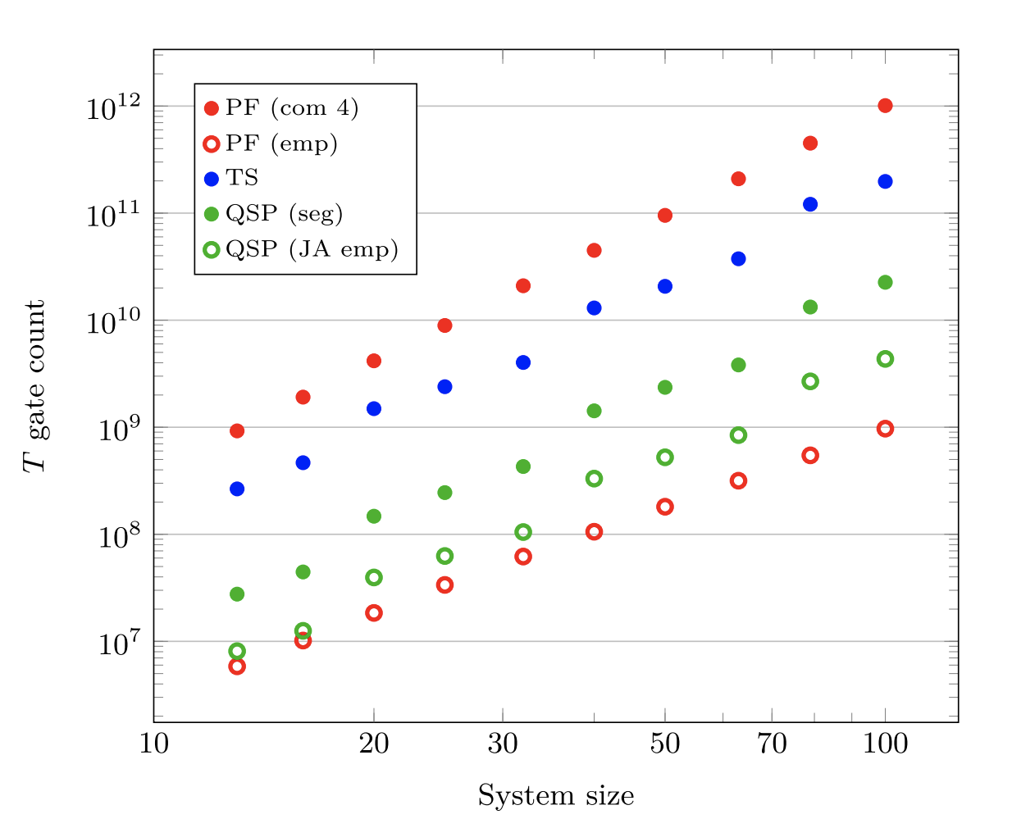
How to choose the right algorithm?
Number of gates for a specific instance vs. complexity
Optimized to a specific Hamiltonian
Provable vs. empirical runtime
Required precision
Ease of implementation
[Childs et al. 2018]

Slide 16
Summary and Outlook
Better understanding of the computational difficulty of Hamiltonian simulation.
Lowering resource estimates.
Applications of Hamiltonian simulations in other areas.

