Slide 1
My work as a quantum algorithms researcher
Maria Kieferova

Slide 2
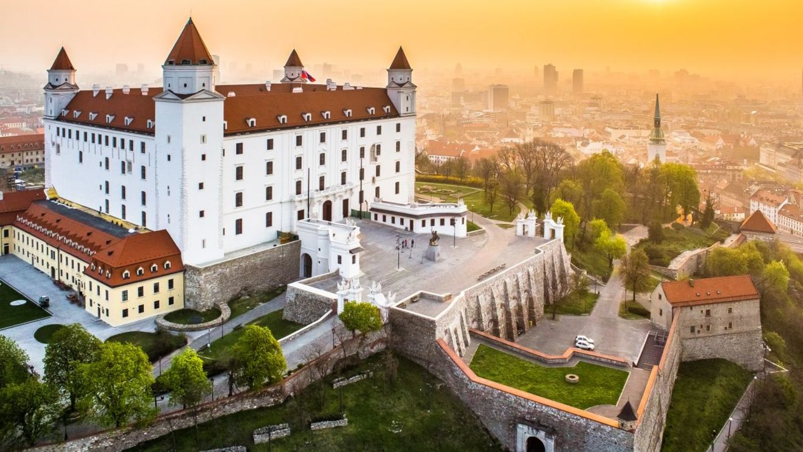
Comenius University (Slovakia)
[Slovakia Travel]

Slide 3
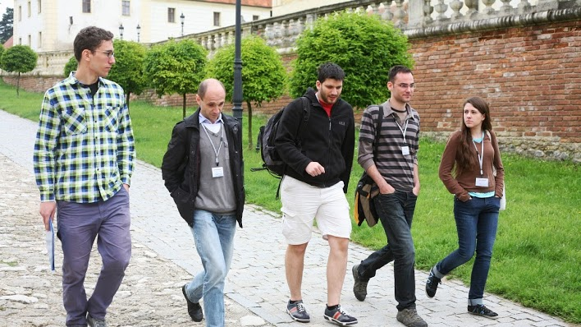
Slovak Academy of Sciences
[CEQIP]

Slide 4
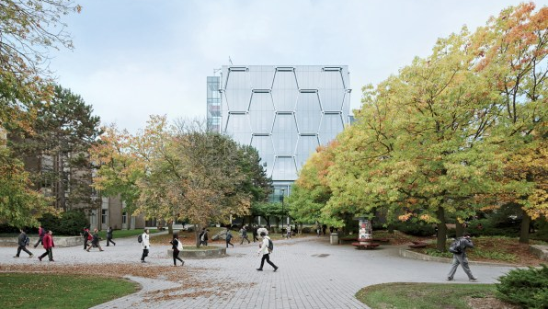
Waterloo IQC (Canada)
[Fast Company]

Slide 5
Macquarie University
[Time Out]

Slide 6
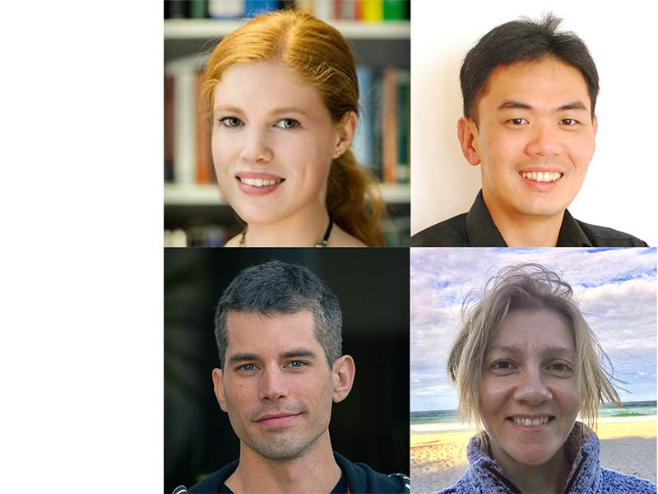
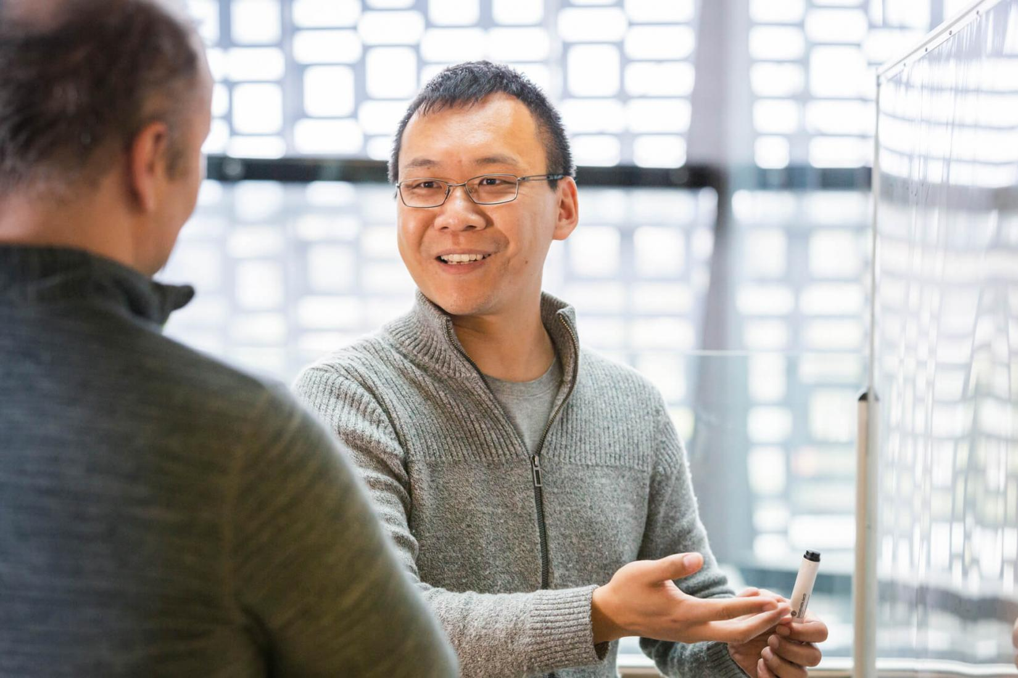
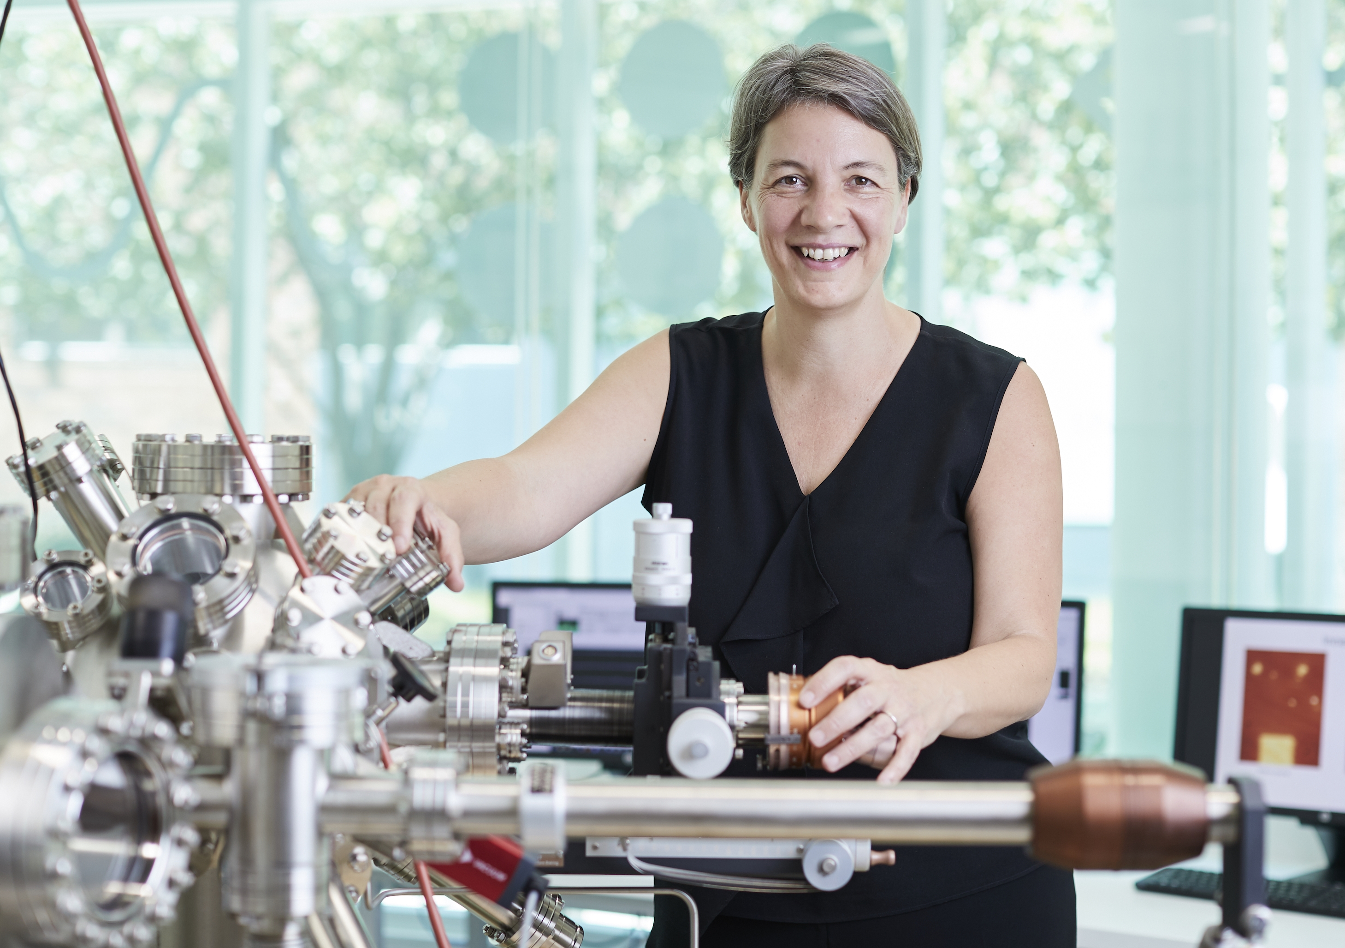
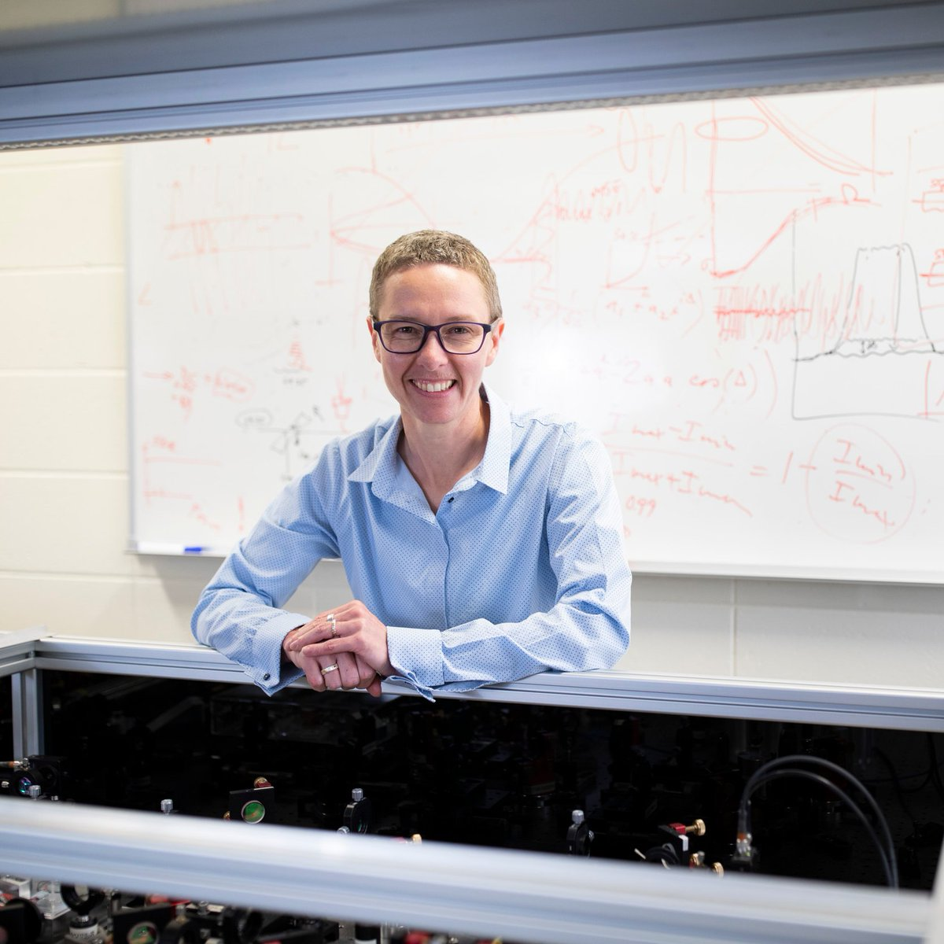
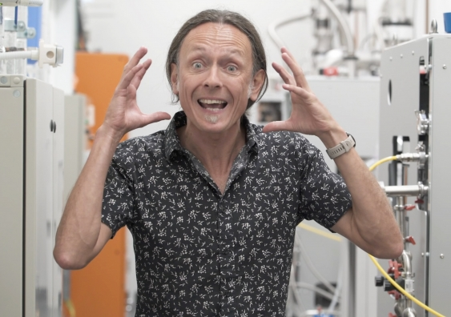
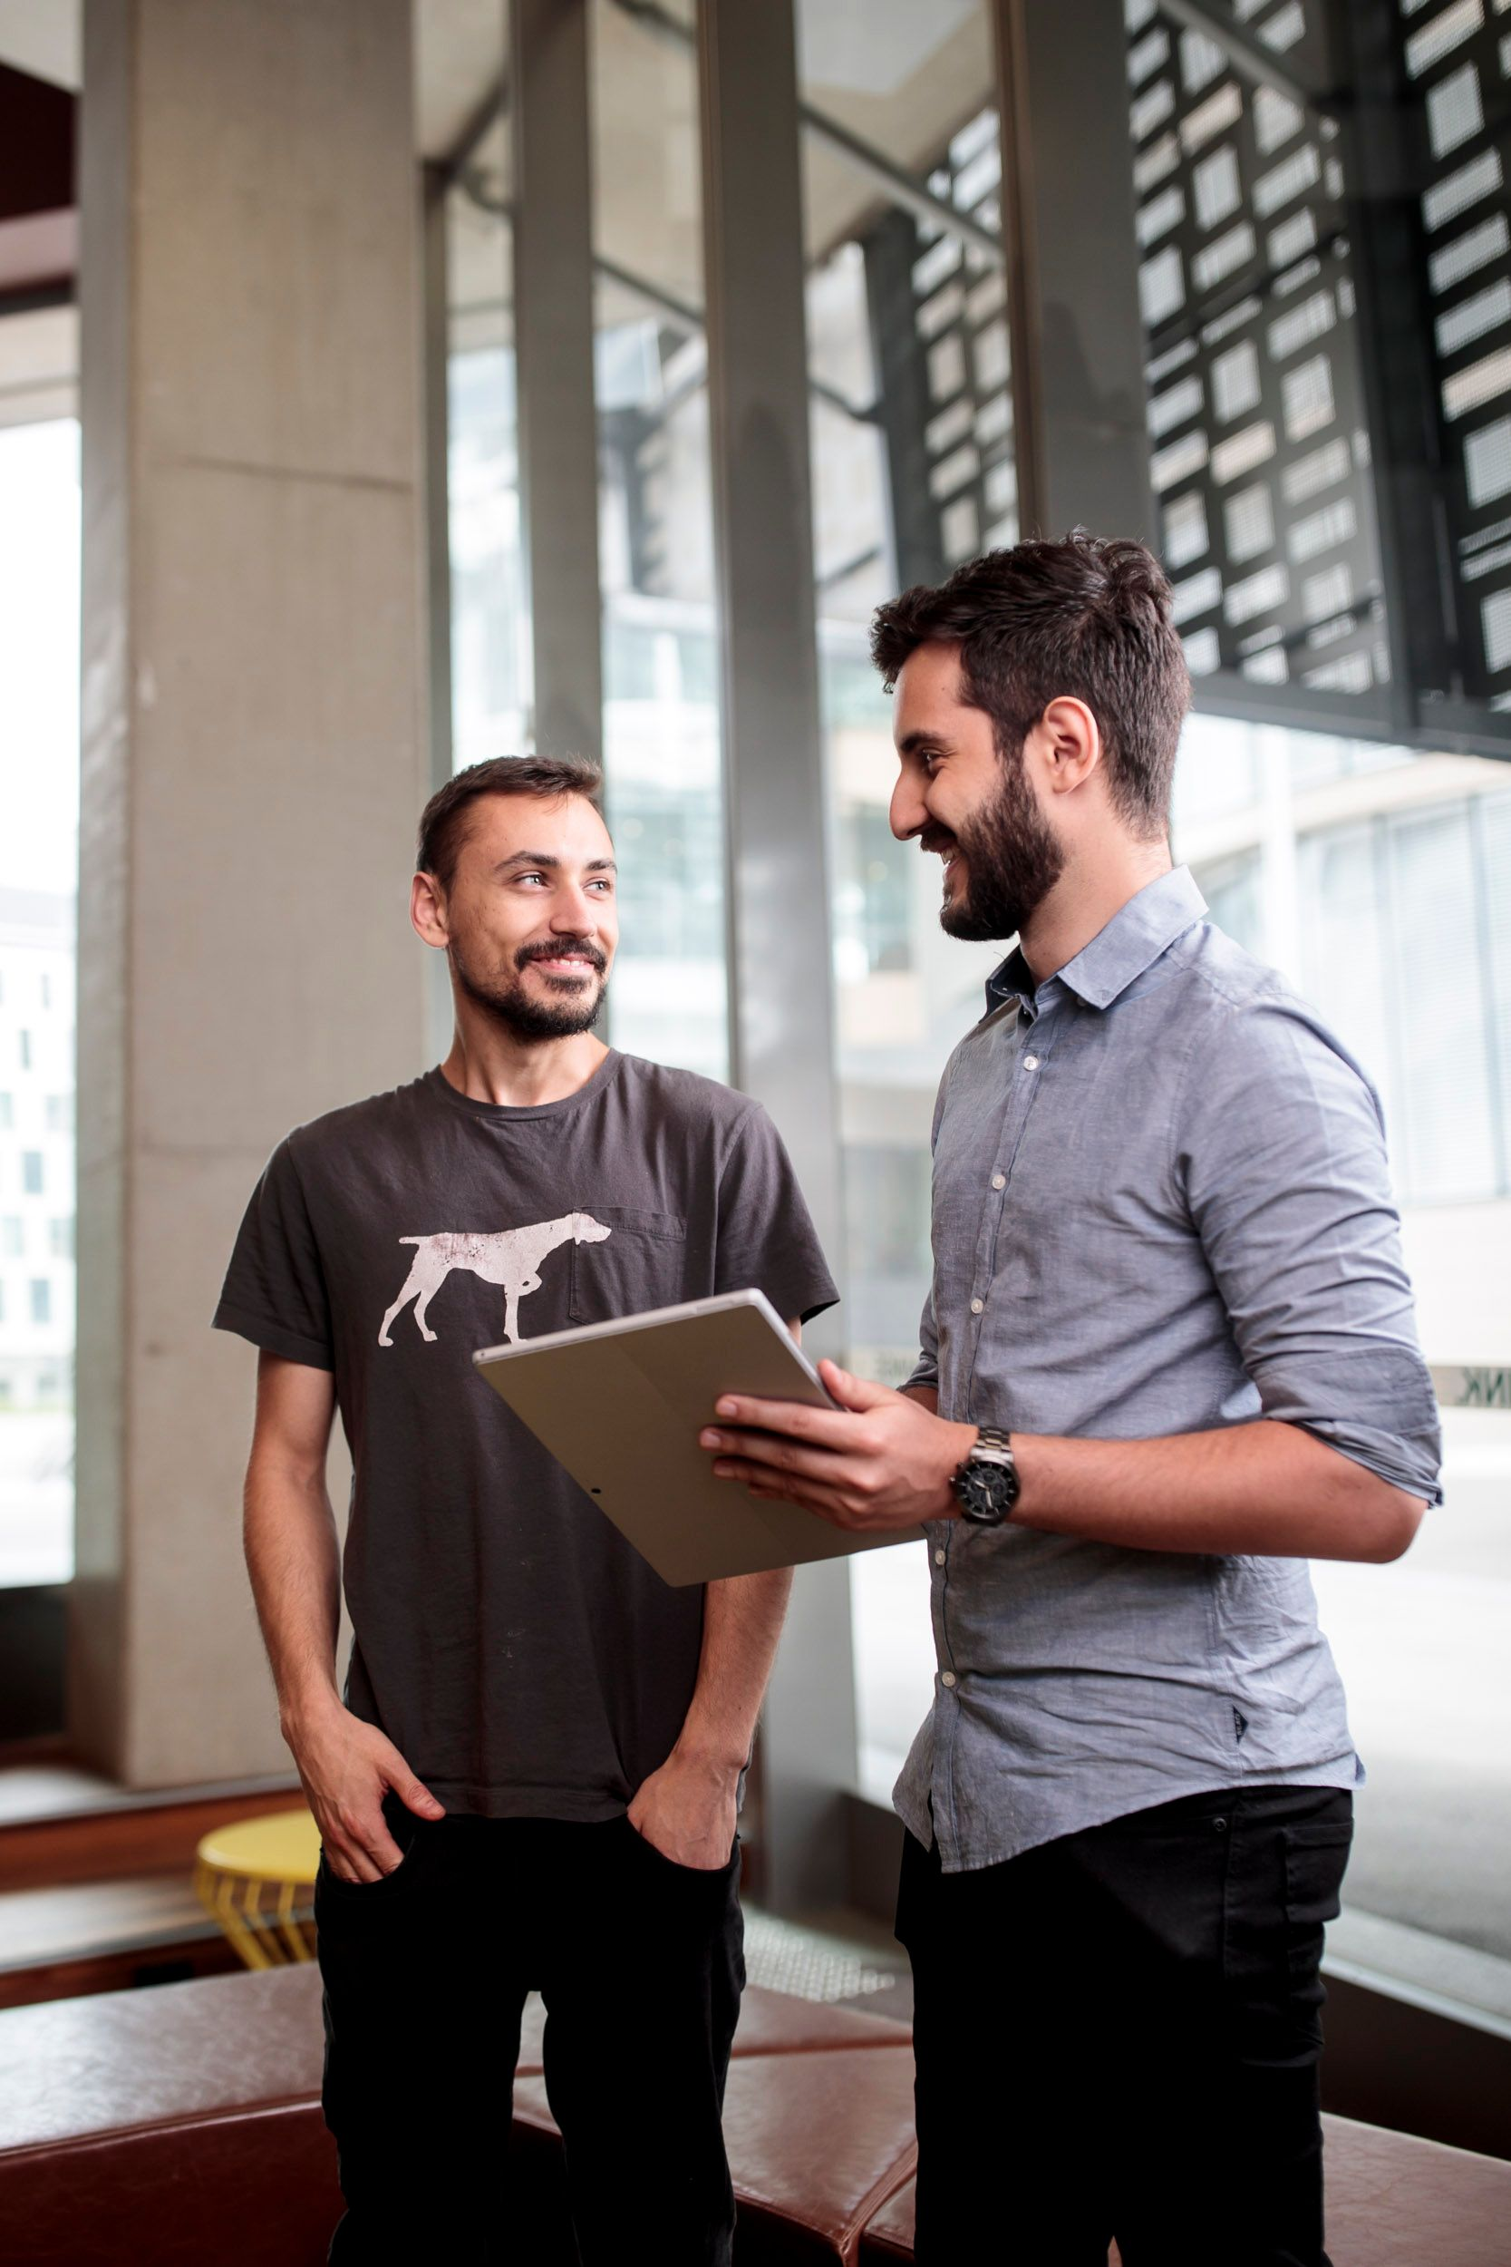
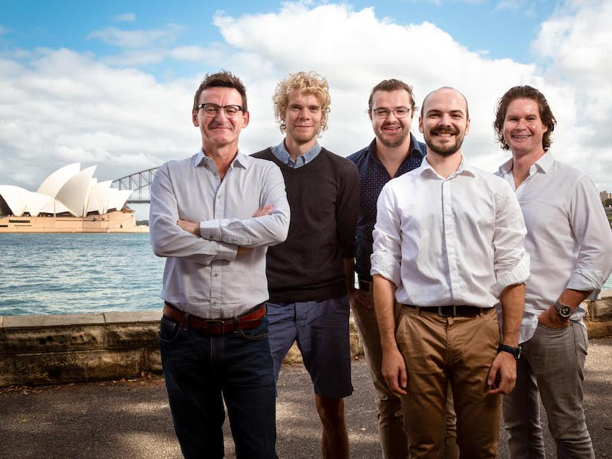
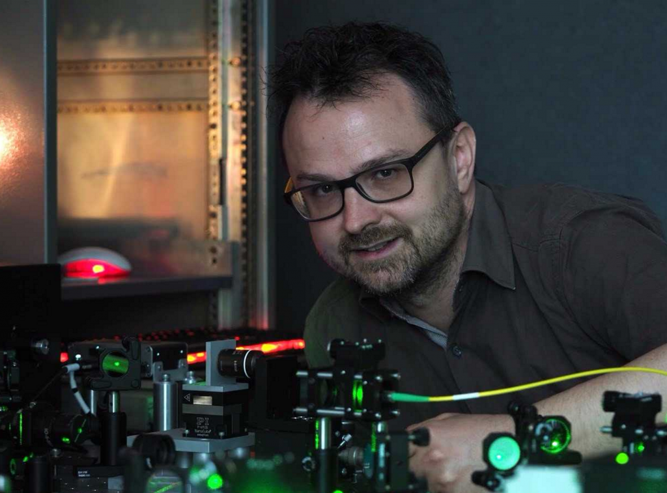
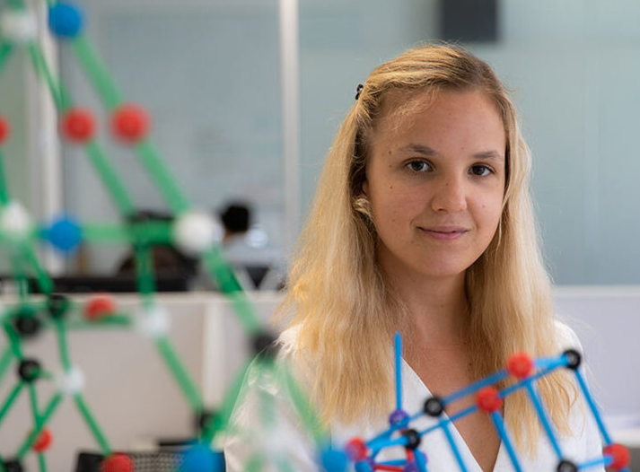
[SQA, UNSW, CQC2T, UTS]

Slide 7
4 universities
70+ faculty members in quantum computing and enabling technologies
[SQA, UNSW, CQC2T, UTS]

Slide 8
PhD scholarship open now
Postdoc fellowships
Industry engagement
https://www.sydneyquantum.org/

Slide 9
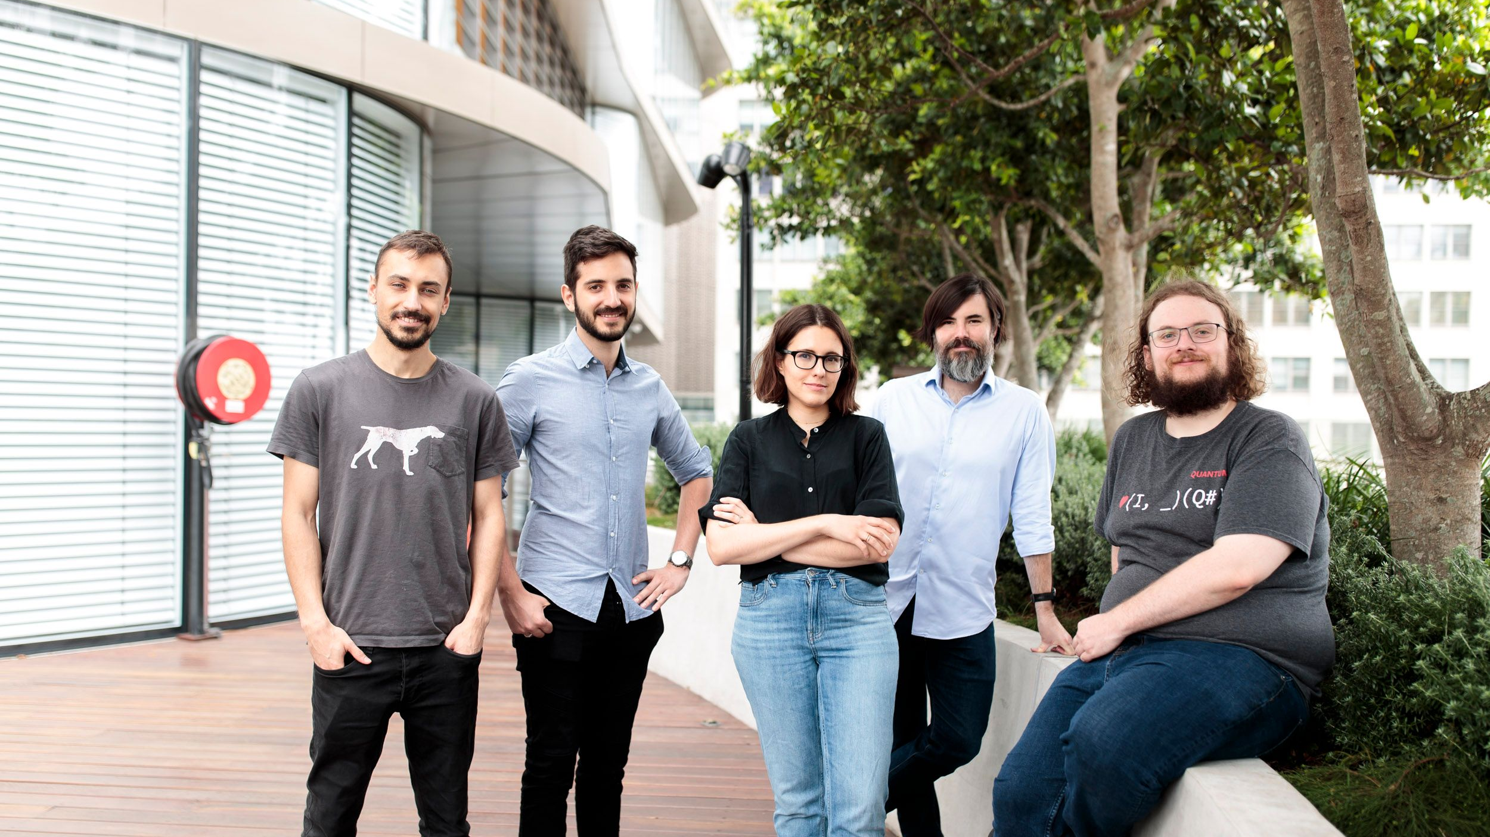
Prof. Bremner’s group
[CQC2T]

Slide 10
What are the applications of quantum computers?
What problems can we solve more efficiently with 100/1000/10⁶ very good qubits?
What are the problems where quantum computers eventually outperform classical computers?*
*Given some complexity theoretic assumptions

Slide 11
What are the applications of quantum computers?
Use theoretical computer science to prove speedups in the asymptotic regime.
Requires large, mature quantum computers.
What are the problems where quantum computers eventually outperform classical computers?*
*Given some complexity theoretic assumptions

Slide 12
What are the applications of quantum computers?
Use theoretical computer science to prove speedups in the asymptotic regime.
Requires large, mature quantum computers.
What are the problems where quantum computers eventually outperform classical computers?*
My research focus
*Given some complexity theoretic assumptions

Slide 13
What are the applications of quantum computers?
What problems can we solve more efficiently with 100/1000/10⁶ very good qubits?
Problems that are extremely easy for quantum computers and incredibly difficult for classical ones.
Very difficult to pinpoint when quantum outperforms classical.

Slide 14
Three Questions About Quantum Algorithms
What are the projected applications?
When can we expect to implement it?
How confident are we about the potential speedup?

Slide 15
Shor’s algorithm for factoring
[Medium]

Slide 16
Shor’s Algorithm for Factoring
What are the projected applications?
→ Breaking cryptography
When can we expect to implement it?
→ 20 million (physical) qubits
How confident are we about the potential speedup?
→ Very – exponential speedup compared to the best-known algorithms
[How to factor 2048 bit rsa integers in 8 hours using 20 million noisy qubits, C Gidney, M Ekerå, arXiv:1905.09749]

Slide 17
Random circuit sampling
[Google AI]

Slide 18
Random Circuit Sampling
What are the projected applications?
→ certifiable randomness
When can we expect to implement it?
→ 2019
How confident are we about the potential speedup?
→ Provable subject to CS conjectures

Slide 19
Quantum dynamics simulations
[Arstechnica]

Slide 20
Quantum Dynamics Simulations
What are the projected applications?
→ Quantum Chemistry, New materials, Drug discovery
When can we expect to implement it?
→ 1-10 million qubits
How confident are we about the potential speedup?
→ Provable subject to CS conjectures
→ Application dependent

Slide 21
Speedup killers
Problems too big for quantum chips
Loading/storing lots of data
Lots of arithmetic
Inherently sequential problems
[Network world]

Slide 22
Speedup killers
Problems too big for quantum chips
Loading/storing lots of data
Lots of arithmetic
Inherently sequential problems
If a problem can be solved on a quantum computer it doesn’t
mean it would be faster than solving it on a classical computer.
[Network world]

Slide 23
My favorite quantum algorithms resources
An Introduction to Quantum Computing (Kaye, Laflamme, Mosca)
Quantum Computation and Quantum Information (Nielsen & Chuang)
Ronald de Wolf’s lecture notes
Andrew Child’s lecture notes
QIP conference talks and corresponding papers.

Slide 24
My favorite quantum algorithms resources
An Introduction to Quantum Computing (Kaye, Laflamme, Mosca)
Quantum Computation and Quantum Information (Nielsen & Chuang)
Ronald de Wolf’s lecture notes
Andrew Child’s lecture notes
QIP conference talks and corresponding papers.
Thank you!

